Slide 1
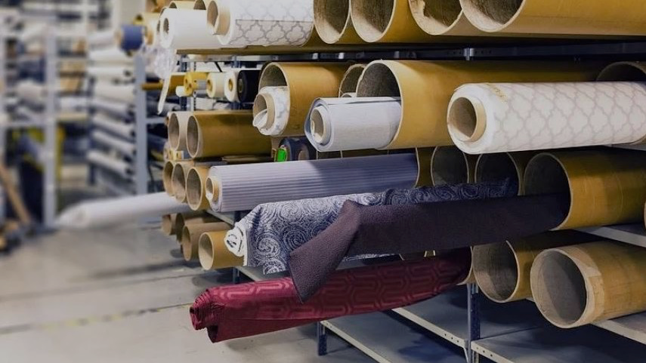
Textile Error Detection Smart Manufacturing Initiatives IOD Capstone Project
Sang Don Lee 03/12/2020

Slide 2
AGENDA
1. PROJECT CONTEXT
2. ADDRESS PROBLEMS
3. PRE-PROCESSING
4. DESIGN
5. Summary & Possible E2E Solution

Slide 3
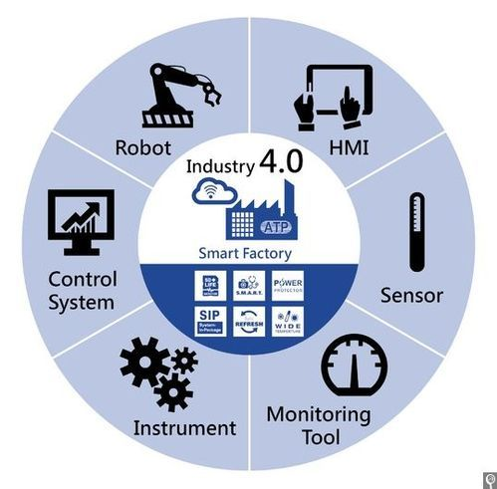
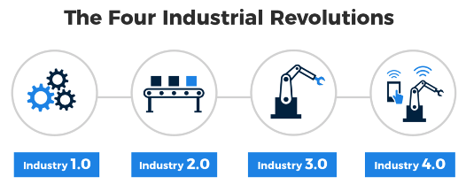
Industry 4.0 & Smart Factory
Industry 4.0 – 4th Industry Revolutions
Economic Impact from Smart Factories, value add $1.5T to $2.2T between 2017 - 2023**
source: https://www.capgemini.com/au-en/news/smart-factories-set-to-boost-global-economy-by-1-5-trillion-by-2023/

Slide 4
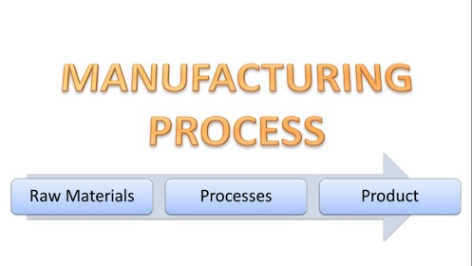
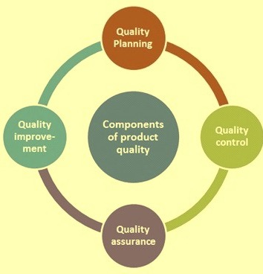
MANUFACTURING PROCESS
QUALITY COMPONENTS
QUALITY PLANNING
QUALITY CONTROL
QUALITY ASSURANCE
QUALITY IMPROVEMENT

Slide 5
AGENDA
1. PROJECT CONTEXT
2. ADDRESS PROBLEMS
3. PROEJCT DESIGN
4. PROJECT DELIVER
5. Summary & Possible E2E Solution

Slide 6
ADDRESS PROBLEMS
STAKEHOLDERS
Textile Manufacturers (or other industries)
Business Owners, QC Managers, Procurement
BUSINESS/DATA
QUESTIONS
We want to initiate Smart Factory transform for a long term.
We have around 70% of textile defect detection rate based on skilled QC Staff.
For a start, how can we implement automated textile defect detection and improve its rate?

Slide 7


Current…

Slide 8
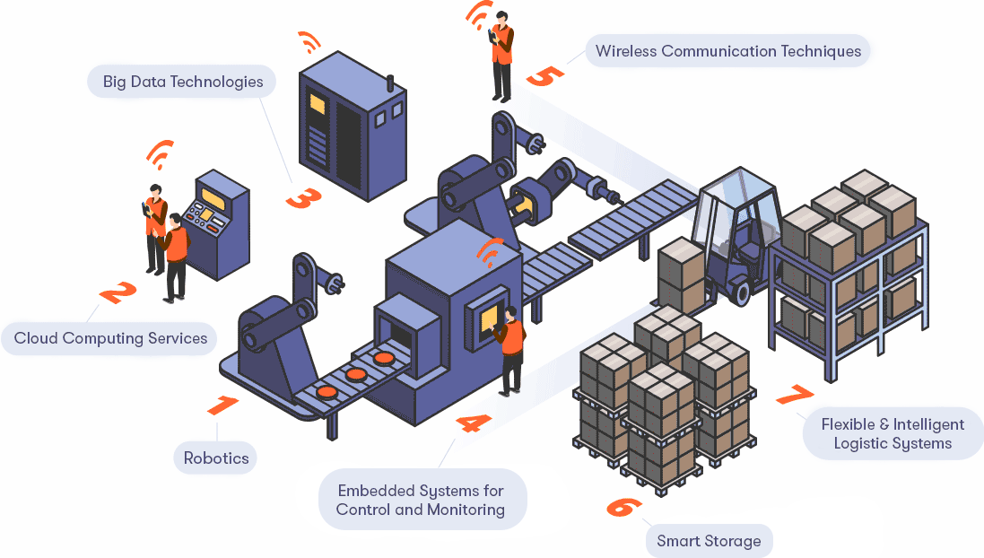
End Goal

Slide 9
AGENDA
1. PROJECT CONTEXT
2. ADDRESS PROBLEMS
3. PROJECT PIPELINE
4. DESIGN & DELIVER
5. Summary & Possible E2E Solution

Slide 10







PROJECT PIPELINE
Stake Holders
Business & Data Questions
Feedback
Image Data
Collection
Image
Pre-processing
Build
MODELs
Evaluation
Solutions

Slide 11
AGENDA
1. PROJECT CONTEXT
2. ADDRESS PROBLEMS
3. PROJECT PIPELINE
4. DESIGN & DELIVER
5. Summary & Possible E2E Solution

Slide 12
DATA INSIGHT (EDA)
Image resolution: 4096 (width) x 256 (height) pixels
Non_Defect_Image Sample
Defect_Image Sample
Mask_Image Sample
Image Data Source: https://www.aitex.es/afid/ : AFID: a public fabric image database for defect detection.

Slide 13
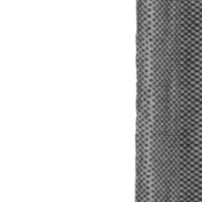
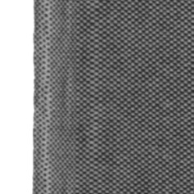

IMAGE PROCESSING
Non_Defect_Image pre-processing
 | Number of Images | PIXEL
Actual | 141 | 4096x256
Processed | 1240 | 256x256
Image Data Source: https://www.aitex.es/afid/ : AFID: a public fabric image database for defect detection.

Slide 14
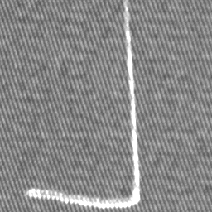
DEFECT TYPES
Broken end | 2 | Broken yarn | 6
Broken pick | 10 | Weft curling | 16
Fuzzyball | 19 | Cut selvage | 22
Crease | 23 | Warp ball | 25
Knots | 27 | Contamination | 29
Nep | 30 | Weft crack | 36

Slide 15
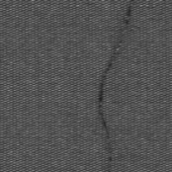
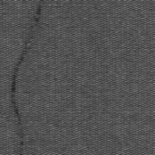
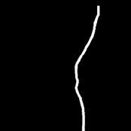

IMAGE PROCESSING
 | Number of Images | PIXEL
Actual | 107 | 4096x256
Defect_Image Sample
Mask_Image Sample
 | Number of Images | PIXEL
Processed | 358 | 256x256

Slide 16
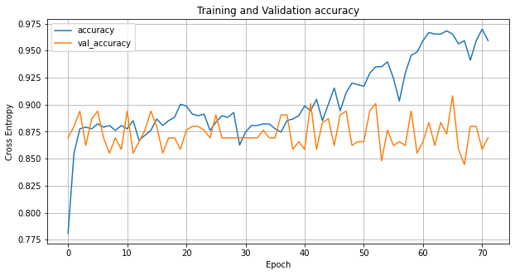
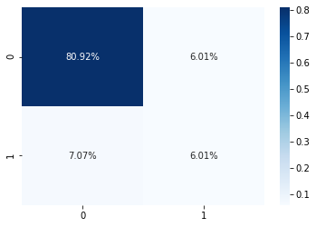
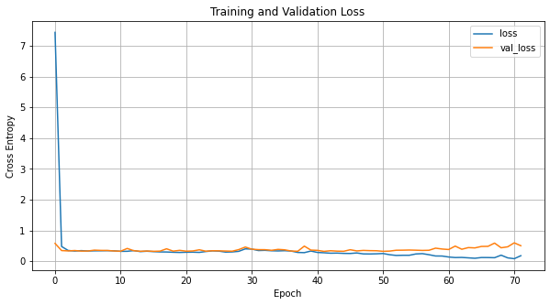
SIMPLE CNN MODELLING
NO IMAGE AUGMENTATION
DATA IMBALANCED!!
USED VERY SIMPLE Sequential CNN
- Early Stopped at 70 Epochs
NO IMPROVEMENT ON
VAL_ACC, VAL_LOSS
Metric | Score
Accuracy | 0.87
Recall | 0.46

Slide 17
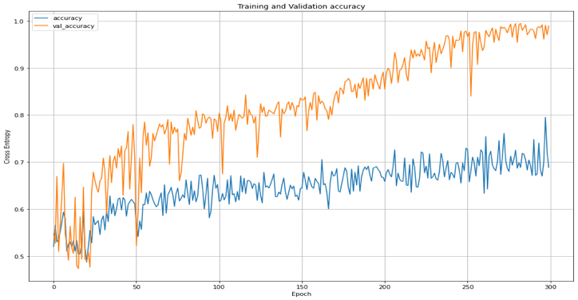
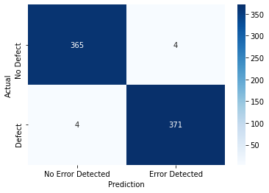
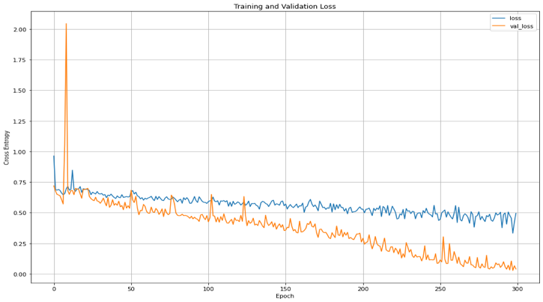
CNN MODEL Performance
Balance the data
Normalisation
Training/Validation (70%/30%)
1736 images
744 images
Image serialization
Image Augmentation
Trained with custom Inception CNN
Metric | Score
Accuracy | 0.99
Recall | 0.99

Slide 18
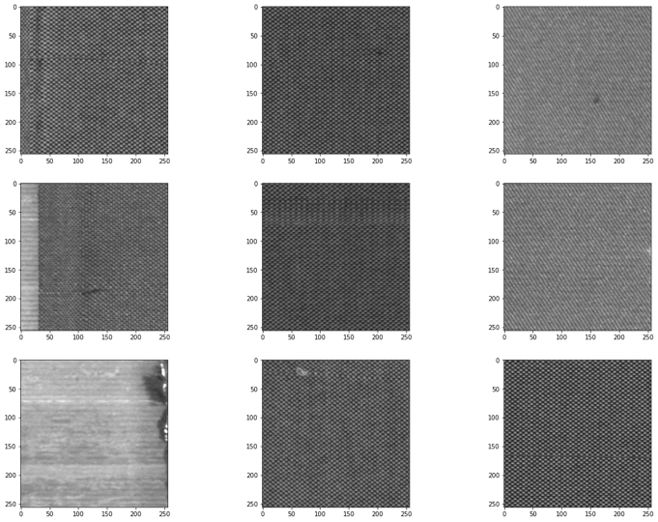
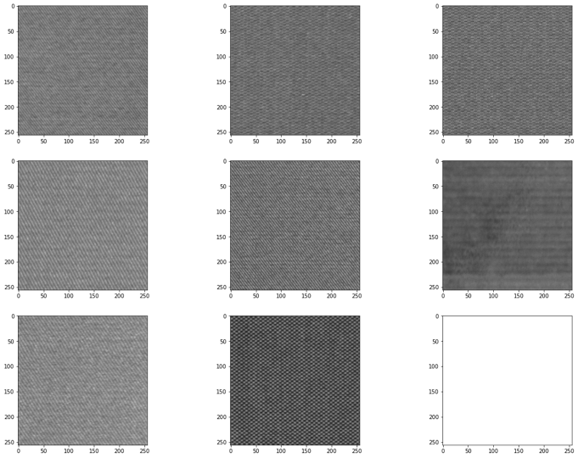
OUTPUT Samples
Detected Defect Images
Detected Non-Defect Images

Slide 19
AGENDA
1. PROJECT CONTEXT
2. ADDRESS PROBLEMS
3. PROJECT PIPELINE
4. DESIGN & DELIVER
5. Summary & Possible E2E Solution

Slide 20
Summary
DATA
Approach
Outcome
Given Image Data
Non-Defect: 140
Defect/Mask: 107
12 Defect Types
Image process
Normalisation
Oversample
- 2,480 images
Image Augmentation
Custom Inception CNN
Dropout
300 Epochs
99% Accuracy
99% Recall

Slide 21
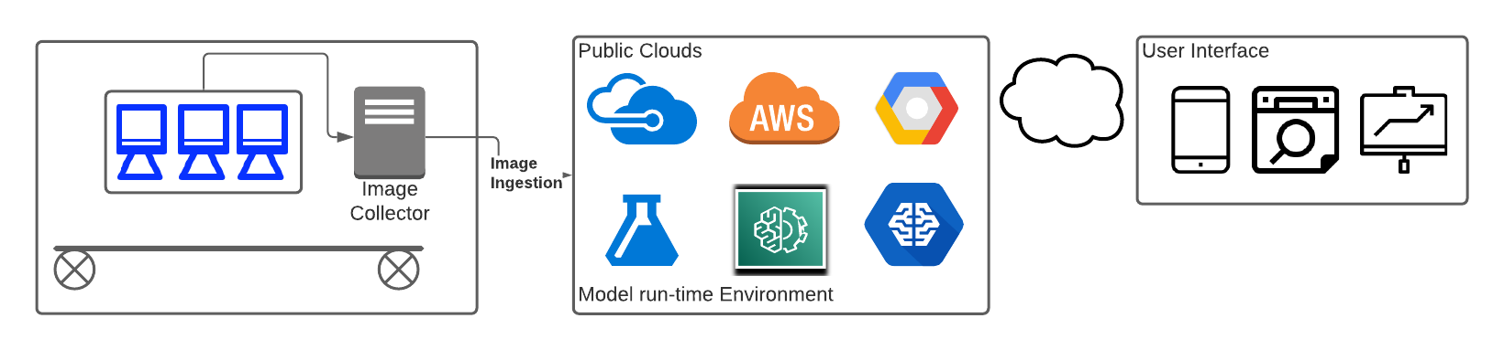
End to End Solution

Slide 22

THANK YOU
Many Thanks to Amin, Abhinav and Miruna!!

